Slide 1
mount / maʊnt / verb to fix something to a wall, in a frame, etc, so that it can be looked at or used
- The surveillance camera is mounted above the main door. mount noun something that an object stands on or is attached to for support
- The engine came loose from its mountings.

Slide 2
screw / skruː / verb attach one thing to another using a screw
screw something into/onto/to something
- The wooden frame should be screwed onto the wall.

Slide 3
editor-in-chief noun the principal editor of a publication, responsible for managing editorial policies and the production of content.

Slide 4
literary / ˈlɪtərəri , ˈlɪtəreri / adjective typical of the style of writing used in literature rather than in ordinary writing and talking.
- a literary style of writing

Slide 5
renovate / ˈrenəveɪt / verb to repair a building or old furniture so that it is in good condition again :
- The hotel has been renovated and redecorated.
renovation / renəˈveɪʃən / noun

Slide 6
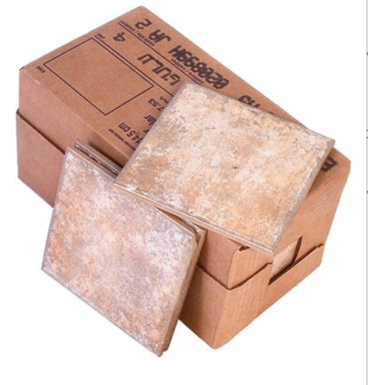
tile / taɪl / noun a flat square piece of baked clay or other material, used for covering walls, floors etc
- bathroom tiles

Slide 7
compensation / kɒmpənˈseɪʃən / noun money paid to someone because they have suffered injury or loss, or because something they own has been damaged
- compensation for injuries at work

Slide 8
happen to do something
if you happen to do something, you do it by chance
- I happened to see James in town.

Slide 9
tablet / ˈtæblət, ˈtæblɪt / noun a small, flat computer that is controlled by touching the screen or by using a special pen

Slide 10
To have trouble (in) doing something

Slide 11
familiarize / fəˈmɪliəraɪz / verb to learn about something so that you understand it, or to teach someone else about something so that they understand it
familiarize yourself/somebody with something
- Employees must familiarize themselves with the health and safety manual.
familiarization / fəmɪliəraɪˈzeɪʃən/ noun

Slide 12
conduct / kənˈdʌkt / verb to carry out a particular activity or process, especially in order to get information or prove facts
conduct a survey/investigation etc
- We are conducting a survey of consumer attitudes towards organic food.

Slide 13
mall / mɔːl, mæl / noun a large area where there are a lot of shops, usually a covered area where cars are not allowed SYN shopping centre
- Let’s meet at the mall and go see a movie.

Slide 14
struggle / ˈstrʌɡəl / verb to try extremely hard to achieve something, even though it is very difficult
struggle to do something
- She’s struggling to bring up a family alone.

Slide 15
parking spot / ˈpɑːkɪŋ spɒt / noun place to park your car but only you can park there .It could be on the public highway, but more likely in a company car park and it would have a number or your name perhaps, or the plate number of your car.
- You'll have to move. That's my parking spot.

Slide 16
postpone / pəʊsˈpəʊn / verb to change the date or time of a planned event or action to a later one SYN put back OPP bring forward
postpone doing something
- The match had to be postponed until next week.

Slide 17
manage / ˈmænɪdʒ / verb to succeed in doing something difficult, especially after trying very hard
manage to do something
- I finally managed to push the huge animal away.

Slide 18
emergency / ɪˈmɜːdʒənsi/ noun an unexpected and dangerous situation that must be dealt with immediately.
- Lifeguards are trained to deal with emergencies .

Slide 19
route / ruːt, raʊt / noun a way from one place to another
- the most direct route home

Slide 20
residential / rezəˈdenʃəl ˌrezɪˈdenʃəl / adjective a residential part of a town consists of private houses, with no offices or factories
- a quiet residential neighbourhood

Slide 21
detour / ˈdiːtʊə / noun a way of going from one place to another that is longer than the usual way
make/take a detour
- We took a detour to avoid the town centre.

Slide 22
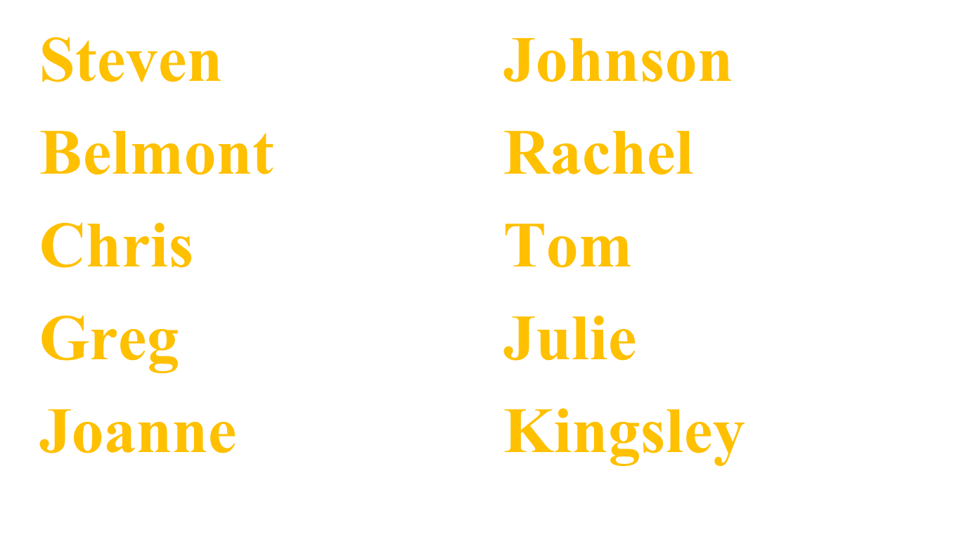

Slide 23
THANK YOU

